Slide 1
AI in Education Teachers as Coordinators of Cooperative Teaching Agents
How Generative AI is Disrupting Education
Dan McCreary
November 2nd, 2023

Slide 2
Talk Description
Education will change more in the next five years than in the past 2000 years. This talk will describe how AI is being used today to generate customized lesson plans, animations, and simulations that are quickly contextualized to the student. We will also discuss how these changes will have a dramatic impact on higher education.

Slide 3


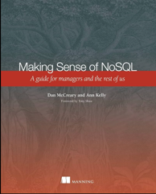



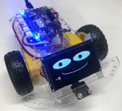


Background for Dan McCreary
Solution architect with over 35 years working with data
Worked for Bell Labs and Steve Jobs at NeXT
Author of a book on database selection “Making Sense of NoSQL”
Promoter of XML and graph query standards (GQL)
Former Distinguished Engineer working for Optum (UHG)
Built the worlds largest healthcare knowledge graph
Lead the “Generative AI Center of Excellence” at Optum
Worked with over 250 healthcare uses cases – 50 which were funded and over 10 in production
Blogger: http://medium.com/@dmccreary
Big fan of AI, robotics, MicroPython, and STEM education
https://www.linkedin.com/in/danmccreary

Slide 4
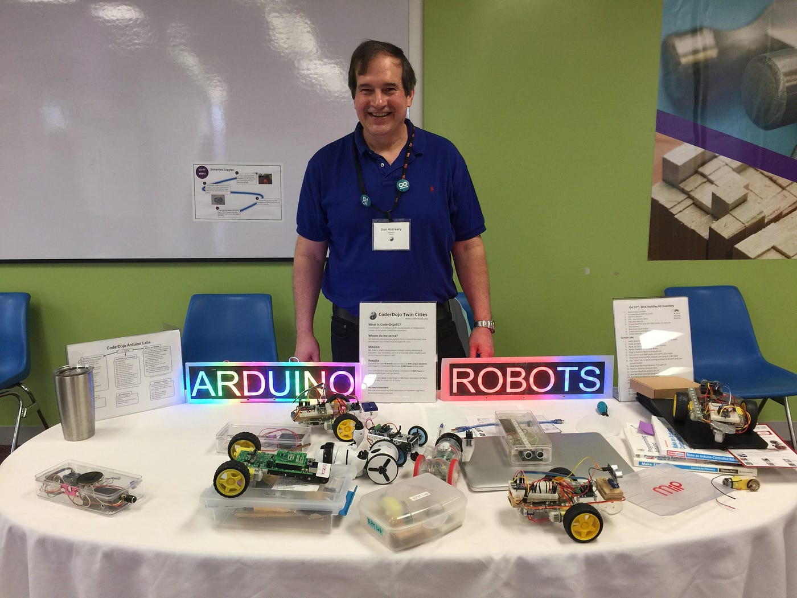
I Love Educational Robots!

Slide 5
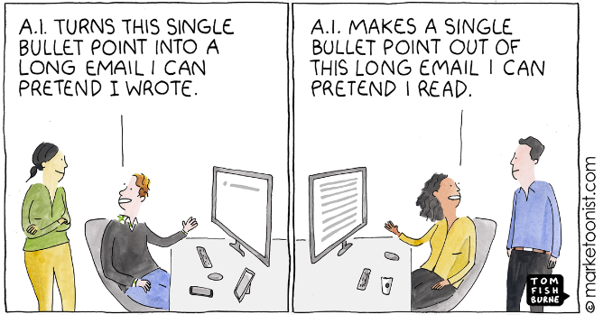
Content Generation and Summarization

Slide 6
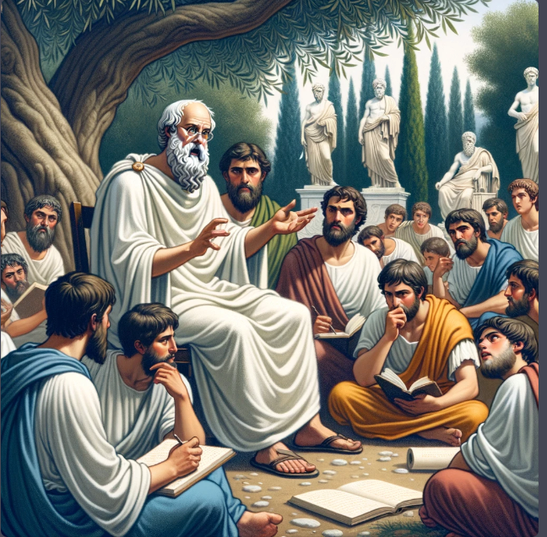
Learning 2000 Years Ago
One teacher
One lecture
30 students

Slide 7
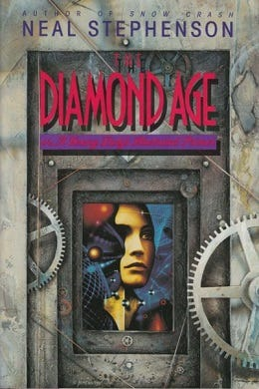
Inspired by Science Fiction
Diamond Age - A Young Lady’s Illustrated Primer is a landmark 1995, Neal Stevenson cyberpunk novel
The intelligent agent is called “The Primer”
It takes the form of a tablet that continually generates customized illustrated stories for a young girl to help her learn
Customized contextual storytelling is a critical component of its strategy
https://dmccreary.medium.com/chatgpt-brings-us-closer-to-the-diamond-age-b1469bee4949

Slide 8


Consider the Modern Busy Teacher
One teacher
1 lesson plan
30 students

Slide 9
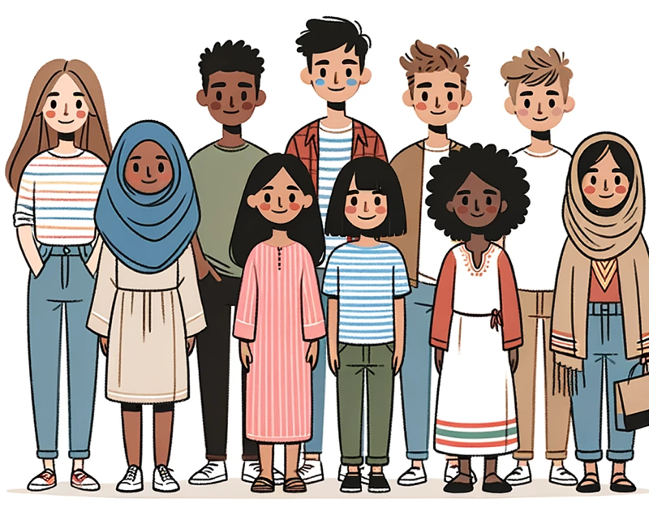
Fact: No Two Students are Alike
Different backgrounds in math
Different first languages - not all English native speakers
Different levels of curiosity
Different amounts of sleep last night
Image: DALL-E 3

Slide 10
Not all students learn at the same rate
Number of Students at Rate
Target
Rate
Medium Learners
Slower Learners
Faster Learners
Learning Rate

Slide 11

But What If The Teacher Could…
Quickly generate many customized interactive lesson plans
Use the prior week’s quiz to customize the lesson plans
Does this work today? YES!
ChatGPT Prompt: Generate three lesson plans for a session on using the sine and cosine function to draw the hands of a clock. The first lesson plan is for students that need extra help and don't have a strong background in math. The second lesson plan is for students that learn faster and pick up new ideas in a short amount of time. The third lesson plan is for advanced students that quickly master concepts and would like to apply their knowledge to other areas.

Slide 12
Yes, It Works!
Lesson Plan 1: For Students Needing Extra Time
Objective: To understand the basic concepts of the sine and cosine functions and their relationship with the hands of a clock.
Introduction:
Discuss the face of a clock and how it represents a circle.
Introduce the concept of the unit circle.
Basic Trigonometry Introduction:
Discuss right triangles and the basic trigonometric ratios.
Introduce the sine and cosine functions as they relate to right triangles.
Clock Hands and Trigonometry:
Discuss the rotation of clock hands and the angles they create.
Use a manipulative or model clock to show the motion of hands.
Relate the position of the hour and minute hands to angles.
.
Lesson Plan 3: For Advanced Students
Objective: To master the use of the sine and cosine functions for clock hands and extend the knowledge to more complex scenarios.
Introduction:
Quick recap of sine and cosine with the unit circle and clock analogy.
Deep Dive into Circular Motion:
Introduce radians as another measure of angles.
Explain the relationship between degrees and radians.
Activity:
Challenge students to convert clock times into radians.
Compute sine and cosine values in terms of π.
Advanced Application:
Introduce the concept of parametric equations.
Task students to come up with parametric equations that describe the motion of clock hands using sine and cosine.
Extension:
Discuss the application of sine and cosine in physics (e.g., pendulum motion, oscillations).
Chat Transcript https://chat.openai.com/share/d043e4a0-eb4c-4a63-8b7c-90f504a76866:

Slide 13
What About Static Textbooks?
Static text
Static diagrams
Compared to Tic-Tok
…Boring, boring, boring
Can AI Generate Fun Interactive Simulations?

Slide 14
Make me a Simulation…
ChatGPT Prompt: Generate a p5.js sketch file of a simulation of a static pulse width modulation (PWM) waveform on a 600x300 canvas.
Add a range control slider to adjust the duty cycle of the waveform
with a default value of 50%. The minimum should be 0% and the maximum should be 100%.
Make sure the range control slider has a width of 400px using the style attribute.
At the end of the draw() function add a text() function that displays
the label and value of the duty cycle.

Slide 15
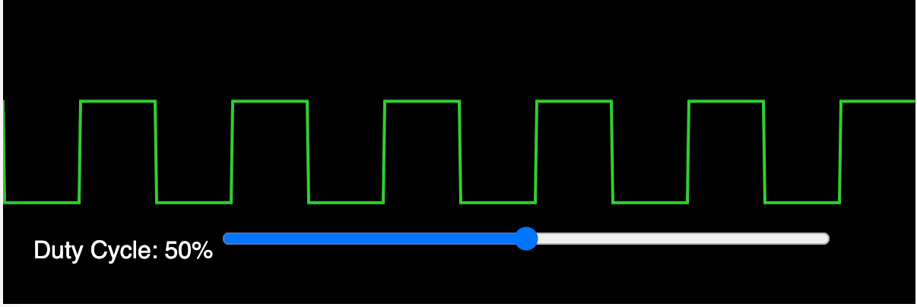
Pulse Width Modulation Demo
Interactive slider
https://www.coderdojotc.org/chatgpt-for-teachers/demos/p5/pwm.html

Slide 16
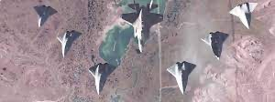
One Piloted Jet and Many Drones
Cooperative Combat Aircraft (CCA) -> Cooperative Teaching Agents (CTA)

Slide 17
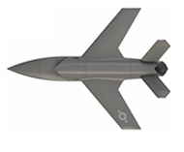

One Fighter with a Human Pilot to Many Drones
Human Jet: $100M
Drone Jet: $1M
Drones will become the “Force Multiplier”

Slide 18
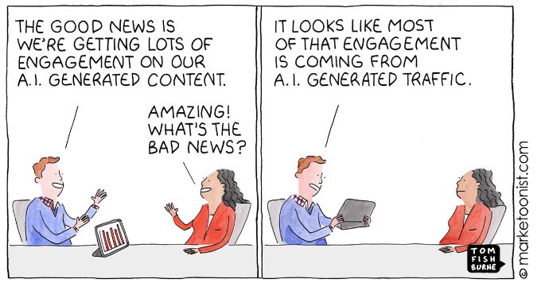
The Dropping Cost of Content

Slide 19
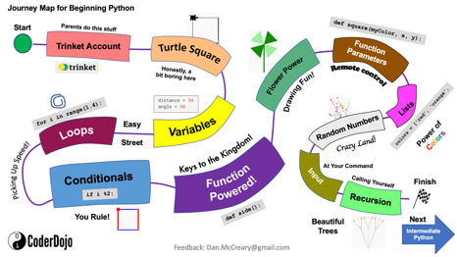
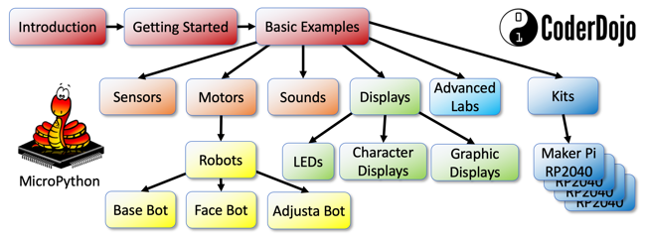
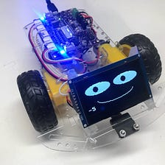
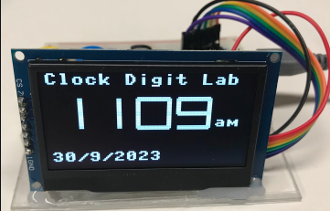
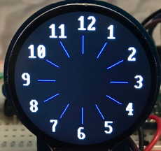
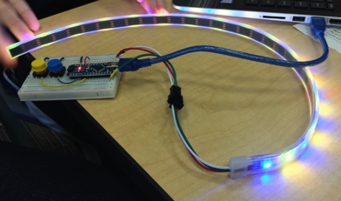
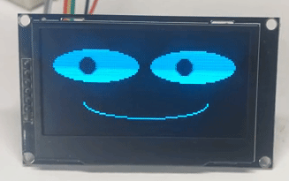
My MicroPython Websites and Projects
Python
MicroPython (15K views/month)
$19 Robot
Robot Faces
WiFi Clocks
Watches
LED Costumes

Slide 20
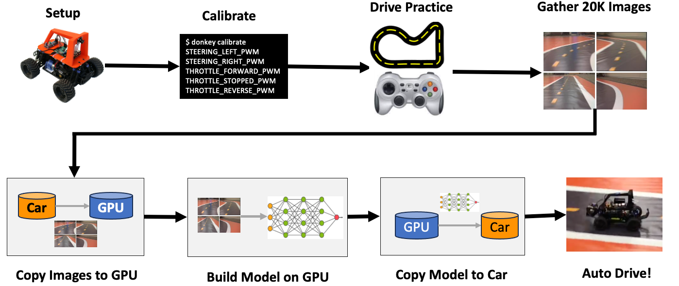
AI Racing League

Slide 21
What is a Cooperative Teaching Agent (CTA) ?
Student
Teacher
Agent
Agent
Shared Knowledge Graph
A software agent that helps both teachers and students learn together by sharing knowledge and tasks
Not just a collection of isolated large-language models and chatbots
Not limited by the interfaces of a single learning management system (LMS)

Slide 22
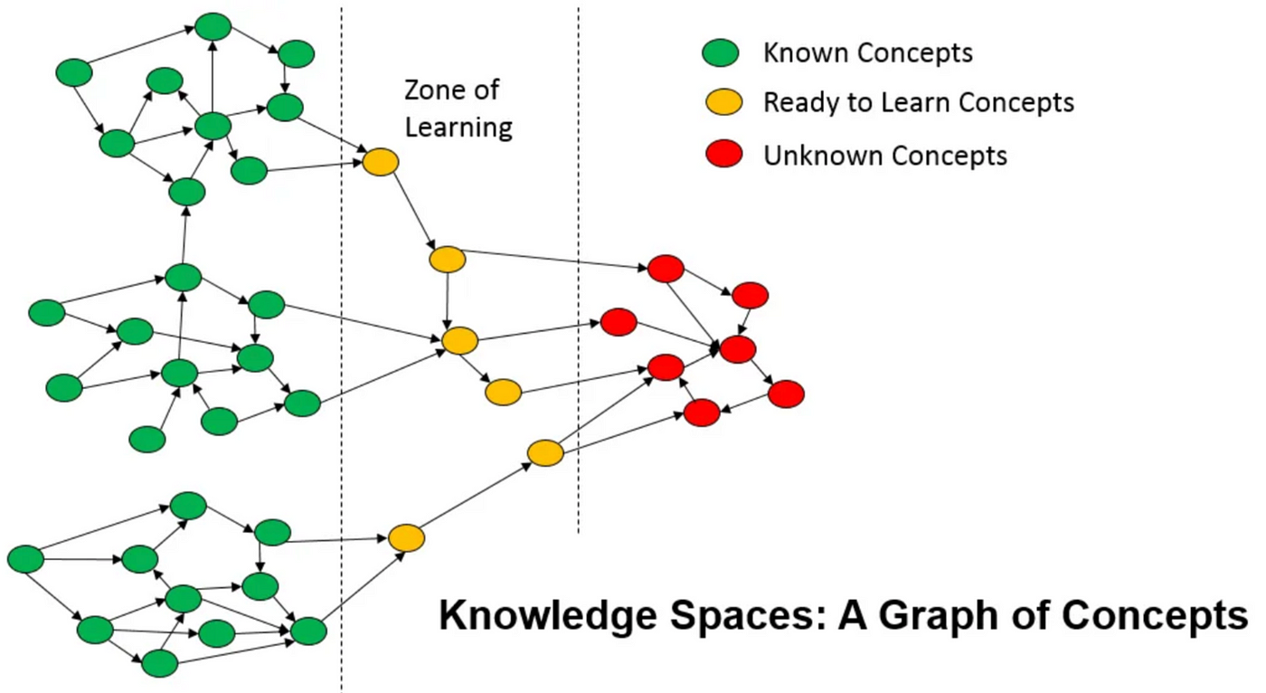
One Student, One Teacher, 10,000 CTAs

Slide 23
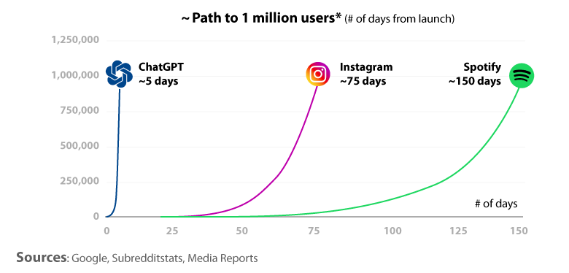
The Rise of Large-Langauge Models
In 2022 we saw the incredible rise of ChatGPT and the growth of large language models
ChatGPT reached over 1 million users in just five days and over 100M users in just a few weeks
But will these large-language models (LLMs) alone help us serve our customers?

Slide 24

Generative AI is Getting Massive New Funding
$40 Billion
In 2023
Over $40 billion dollars was invested in generative AI in 2023
Microsoft alone has invested over $12B in OpenAI
Pitchbook has tracked over $12B in new generative AI funds in 2023
Billions invested in new AI hardware products (FPGA, custom chips)
Many generative AI venture funds are focusing on specialized tasks in specific industries (healthcare)

Slide 25
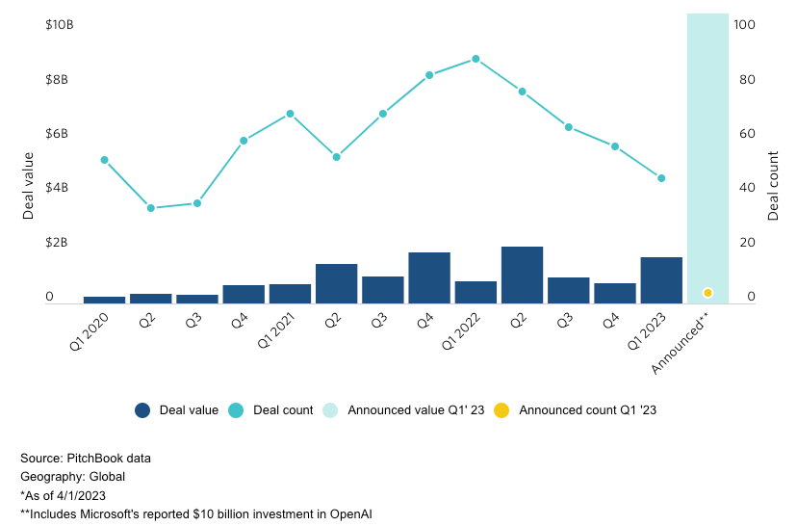
Skyrocketing Growth of Generative AI Investments

Slide 26
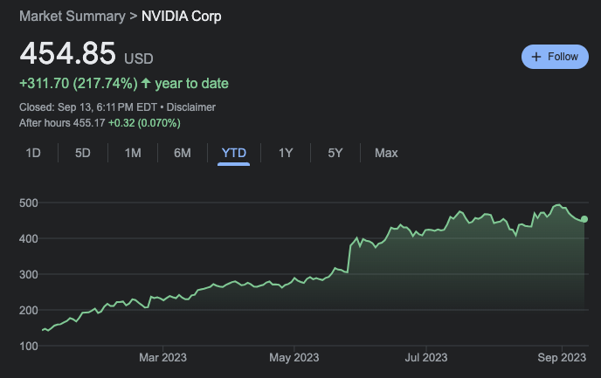
NVIDIA Stock TYD: up 217% in 2023

Slide 27
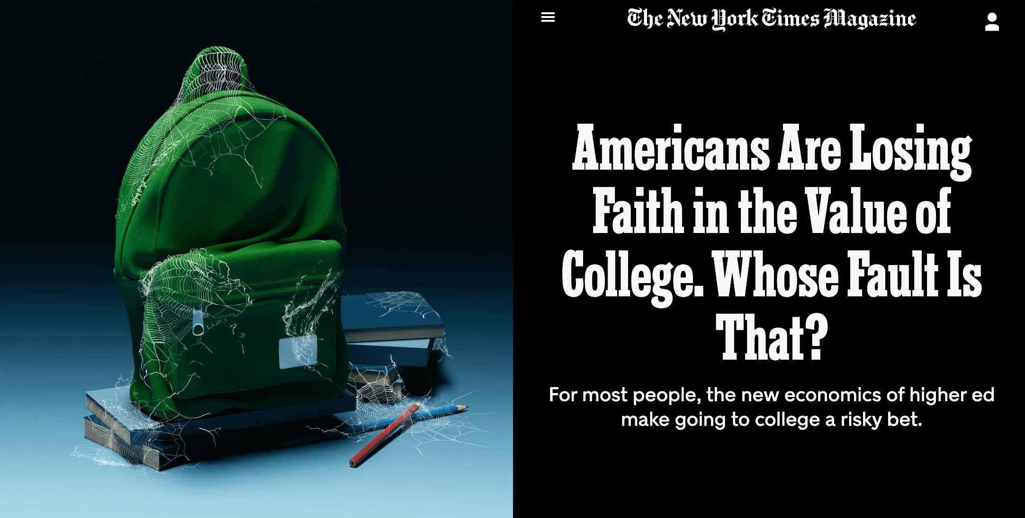
Is College a Good Investment?
https://www.nytimes.com/2023/09/05/magazine/college-worth-price.html

Slide 28
Challenges of the Cost of Education
Expense
Many liberal arts colleges cost over $50K/year
Many students finish college with $100K of student dept
Access
A four-year degree might only be accessible to the very wealthy
Can students from low-income homes get access to quality education?
Confidence in a Four-Year Degree
2010: 90% felt it was a good investment
2023: 40% feel like it is a good investment
Teacher Burn Out
Only 2/3 of teachers stay beyond the 5th year

Slide 29
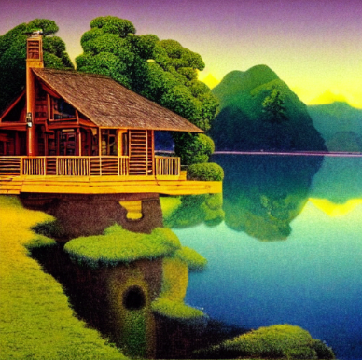
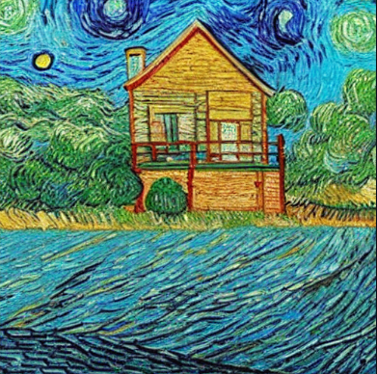

Separation of Content from Style
Create an image of a lake cabin in the style of _______.
Thomas Kinkade
Maxfield Parrish
Vincent van Gogh
Images generated in under 3 seconds each using Stable Diffusion running on my local PC with a GPU.

Slide 30
What Areas is Generative AI Being Used?
Software development acceleration
Acceptance test plans
Code translation (SAS to Python)
$20K/person
Information retrieval
Semantic search
Chatbots
Information extraction
Summarization
Contract analysis
Healthcare patient chart analysis
Document generation
Lesson plans
Legal contracts
Image and video generation
Stable Diffusion, Midjourney, Dalle-2
LoRA –fast custom fine-tuned image generation on a dozen samples
Synthetic data sets
Generating synthetic data sets for testing
Generating sample call center dialogs
Education
Hyper-customization of lesson plans
On-demand simulations

Slide 31
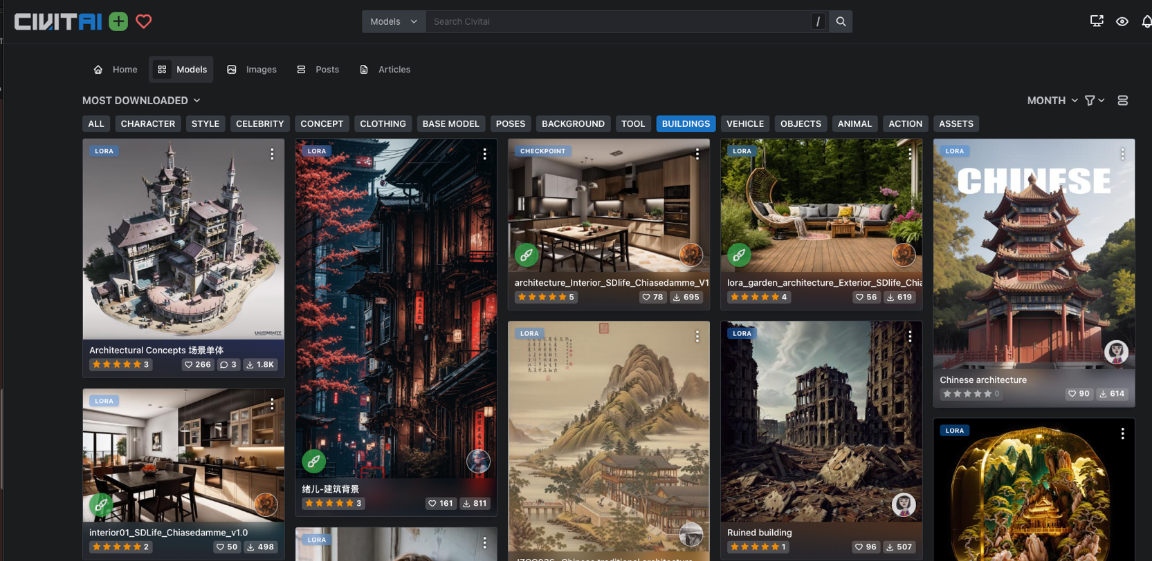
Customization of Models to Generate Buildings

Slide 32



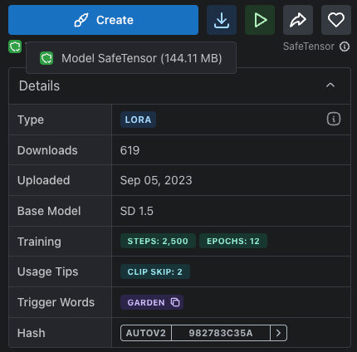
Ideas for Backyard Garden Architecture (LoRA)
144MB!

Slide 33
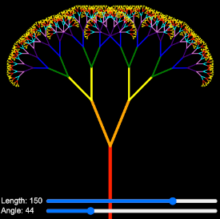
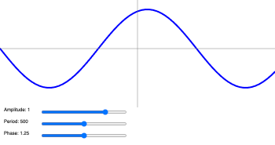
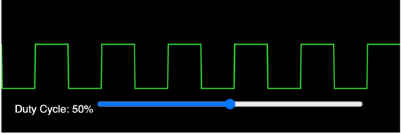
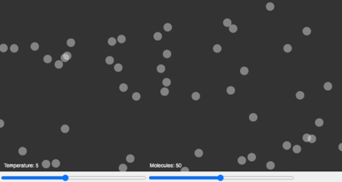
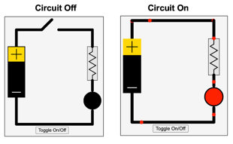
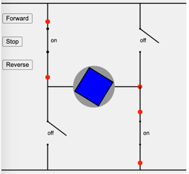
Simulation Generation
Prompt: Create a simulation of : ________
A Sine Wave
Pulse Width Modulation
Recursion
An LED Circuit
A Gas Chamber
An H-Bridge Circuit
http://www.coderdojotc.org/chatgpt-for-teachers/

Slide 34
Conclusion
Teachers will use intelligent agents to become force multipliers
Generative AI can generate lesson plans for each student every day based on their project-based learning goals
The entire concept of education will change
Some “Higher Education” will be almost free

Slide 35

How to Download Slides
Step 1:
https://github.com/dmccreary/dmccreary/blob/master/slides/2023-Ai-in-Education-Thinking-Spot.pptx
Step 2:
Click the Download Icon on the right side:
Click Download Icon

Slide 36
Questions?
Stay Curious!
https://www.linkedin.com/in/danmccreary

